Slide 1
LECTURE 11: Transmission Errors
Sources of Transmission errors
All data communications systems are vulnerable to transmission errors.
There are several sources of these transmission errors but we look at the three main sources of transmission errors namely:
Interference
Distortion
Attenuation

Slide 2
Interference :
is caused by electronic magnetic radiation that may be emitted from devices like electronic motors used in the communication system
This can cause noise that disturbs radio transmission and signals travelling across wires

Slide 3
Distortion All physical systems distort signals, for example when a pulse travels along optic fibre it disperses. Transmission wires have properties of capacitance and inductance that block signals at some frequencies and also allow signals to filter through at other frequencies, for example placing a transmission wire near a large metal object can change the set of frequencies that can pass through the wire. Metal objects can also block some frequencies of radio waves while allowing others to pass through.

Slide 4
Attenuation
When a signal passes through a transmission medium it becomes weaker because of resistance and other opposition forces. So signals propagating on wires or optical fibres become weaker over long distances. The same applies to radio signals which become weaker or fade over long distances.
Errors cannot be eliminated completely in a communications system but can be detected and in some cases corrected automatically.

Slide 5
In communication systems, the following errors are common:
Single bit error
Burst errors
Erasure

Slide 6
Single bit error is when only one bit changes its value in a character or block of characters
burst errors arise when two or more bits change their values in a character or block of characters.
The erasure (ambiguity), the signals that arrive at the receiver are ambiguous, that is difficult to tell.

Slide 7
Error detection codes
These are codes that can detect the presence of errors in a transmission without necessarily correcting them (errors).
Most popular for single bit errors is the parity bit error detection code, which is either even parity or odd parity.

Slide 8
Even parity
In even parity the number of binary ones (1s) must always be even.
At the transmitter every parity bit is calculated and is sent (not as part of data) but is transmitted first or last.
At the receiver the even parity bit is also calculated and compared with the received parity bit.

Slide 9
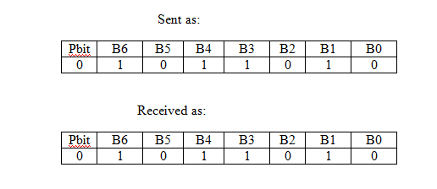
If they are the same the assumption is that no errors occurred during transmission see example below:

Slide 10
The problem with parity bit arises when two bit positions change their values. In this case the parity bit will be correct, so the error is not detected

Slide 11
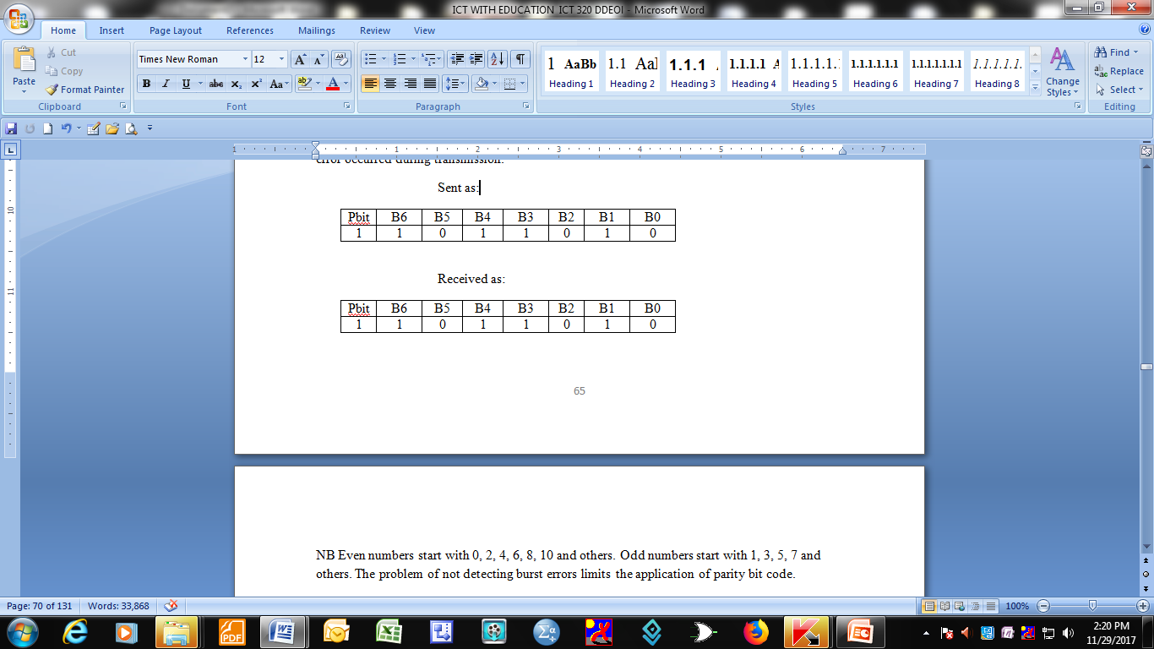
Odd parity
In odd parity, the number of binary ones (1s) must always be odd. If even, the assumption is an error occurred during transmission.

Slide 12
Forward error correction codes
Forward error correction code allow the error detection mechanism at the receiver to determine exactly which bits have been changed and to compute the correct values
See block diagram

Slide 13
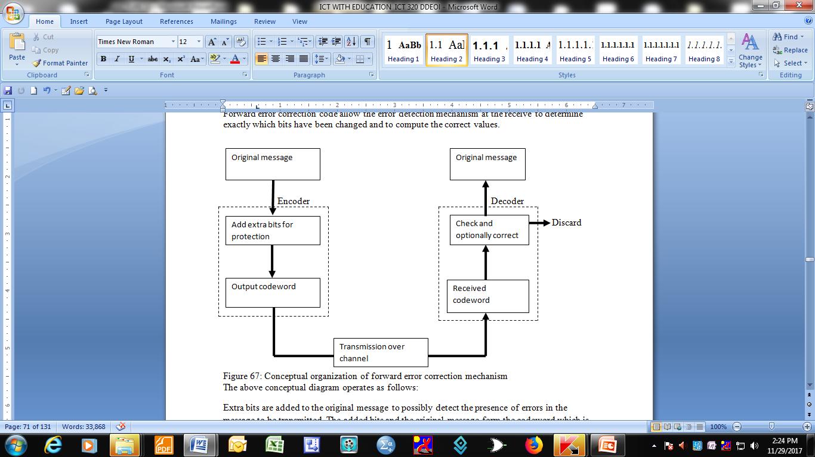
Conceptual organization of forward error detection code(block diagram)

Slide 14
The conceptual diagram operates as follows:
Extra bits are added to the original message to possibly detect the presence of errors in the message to be transmitted.
The added bits and the original message form the codeword which is then passed over to the transmission channel to the receiver.
The received codeword is checked for errors and optionally corrected.
When the errors cannot be corrected, the message is discarded and a re- transmission is requested.

Slide 15
Block Error Correction Codes
Block error correction is implementing by placing a string of bits to be transmitted in an array of rows and columns.
Consider a data word made up of 12 bits. Instead of taking the bits as a single string, they can be arranged in an array of three (3) rows and four (4) columns with a parity bit added for each row and for each column.

Slide 16
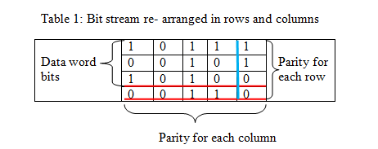
Consider the bit stream to be transmitted: 101100101010.
It is then arranged in a 3 x 4 array

Slide 17
Note that in the above table even parity is being used.
If one bit changes its value from 1 to 0 or vice versa this error will be detected and corrected (see table 2)

Slide 18
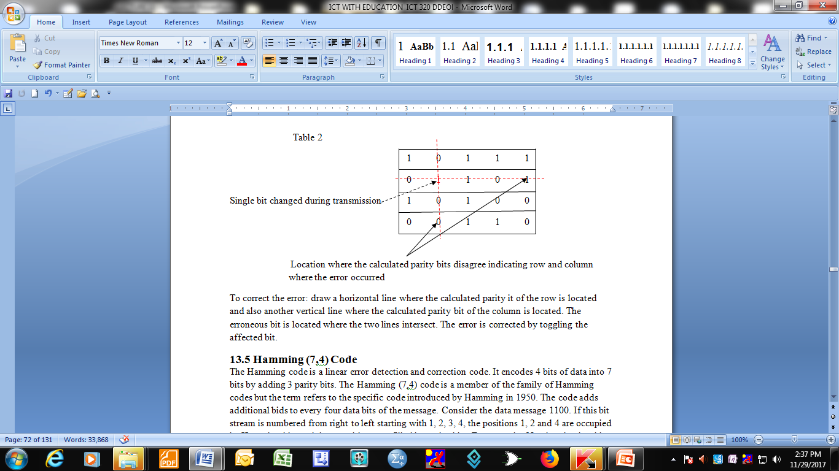
Block error detection and correction

Slide 19
To correct the error:
draw a horizontal line where the calculated parity it of the row is located and also another vertical line where the calculated parity bit of the column is located.
The erroneous bit is located where the two lines intersect.
The error is corrected by toggling the affected bit.

Slide 20
Hamming code
The Hamming code is a linear error detection and correction code.
It encodes 4 bits of data into 7 bits by adding 3 parity bits.
The Hamming (7,4) code is a member of the family of Hamming codes but the term refers to the specific code introduced by Hamming in 1950.

Slide 21
The code adds additional bids to every four data bits of the message.
Consider the data message 1100. If this bit stream is numbered from right to left starting with 1, 2, 3, 4, the positions 1, 2 and 4 are occupied by Hamming bits and these positions are filled by parity bits. For example: Number the data bit stream as shown below:

Slide 22
Calculating Hamming bit values
1⁴ 1³ 0² 0¹
x x x
Insert the Hamming bits marked with xs into the data bits : 1⁷1⁶0⁵ x⁴0³x²x¹
The next step is to calculate the actual binary values of the (Hamming bit positions) xs
Calculation is done using modulo -2 arithmetic or Exclusive OR. Write down all bit positions with a binary 1 and perform modulo-2 arithmetic

Slide 23
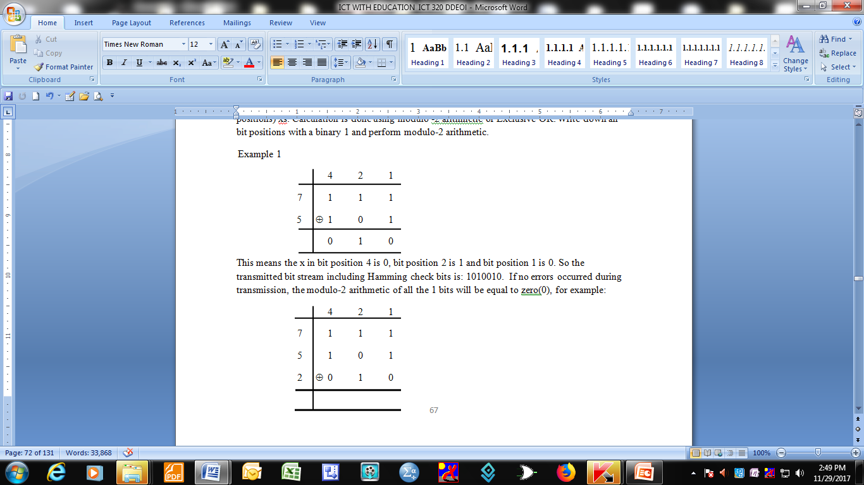

Slide 24
This means the x in bit position 4 is 0, bit position 2 is 1 and bit position 1 is 0. So the transmitted bit stream including Hamming check bits is: 1010010. If no errors occurred during transmission, the modulo-2 arithmetic of all the 1 bits will be equal to zero(0), for example:

Slide 25
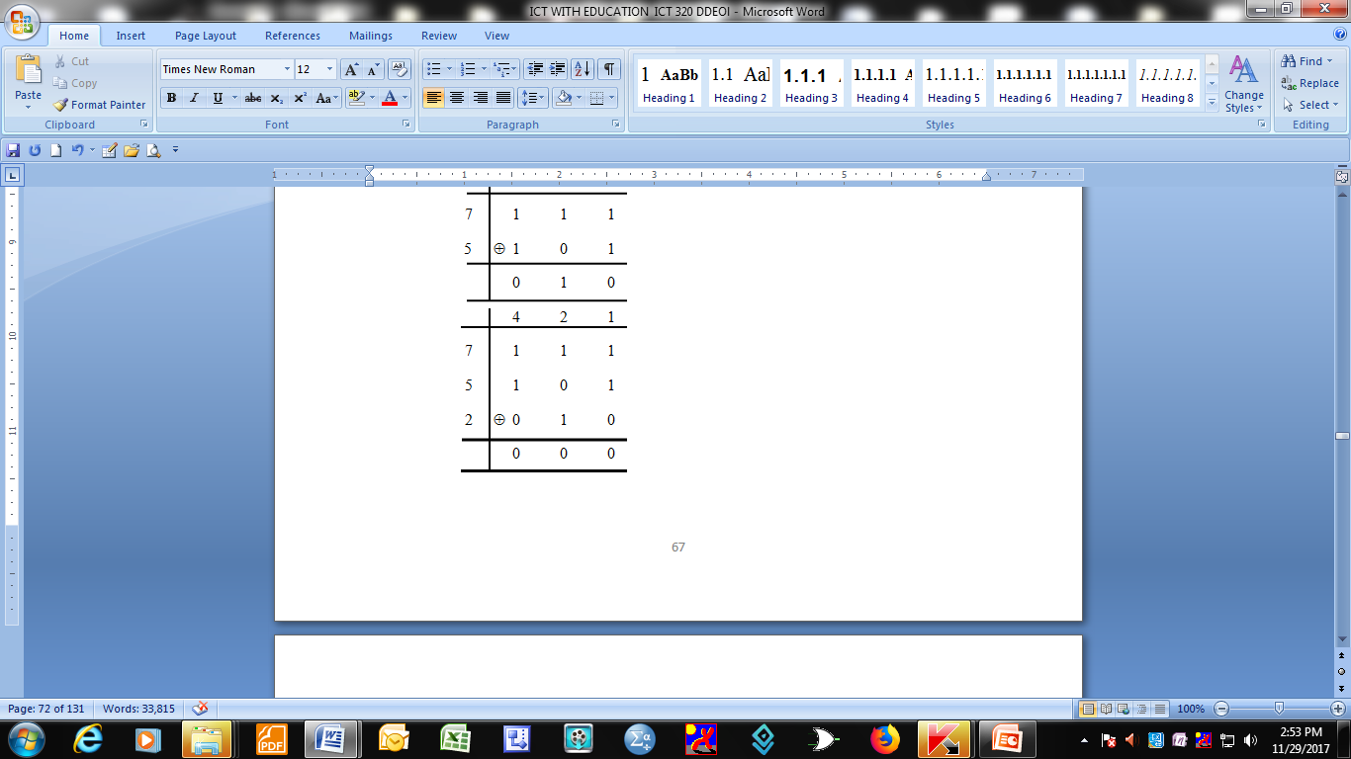

Slide 26
If an error occurred in 1 bit position during transmission, this error will be detected and corrected for example if in the above transmitted message bit position 7 toggled to a zero, modulo-2 arithmetic will produce the result 111 indicating that the error occurred at bit position 7

Slide 27
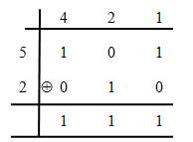
Detecting an error and correcting it

Slide 28
Example 2
Consider a data bit stream 1011001111001011 to be transmitted.
First step is to number the bits so as to know the Hamming bit positions, for example:
¹⁶0¹⁵1¹⁴1¹³0¹²0¹¹1¹⁰1⁹1⁸1⁷0⁶0⁵1⁴0³1²1¹, so the bit positions 16, 8, 4, 2 and 1 are Hamming bit positions and they do not carry data but are used as parity check bits.

Slide 29
We insert xs in these bit positions in the data bit stream and then calculate their actual binary values:
1²¹0²⁰1¹⁹1¹⁸0¹⁷ ¹⁶0¹⁵1¹⁴1¹³1¹²1¹¹0¹⁰0⁹x⁸1⁷0⁶1⁵x ⁴1³x²x¹. We calculate the Hamming bit values using modulo-2 arithmetic:

Slide 30
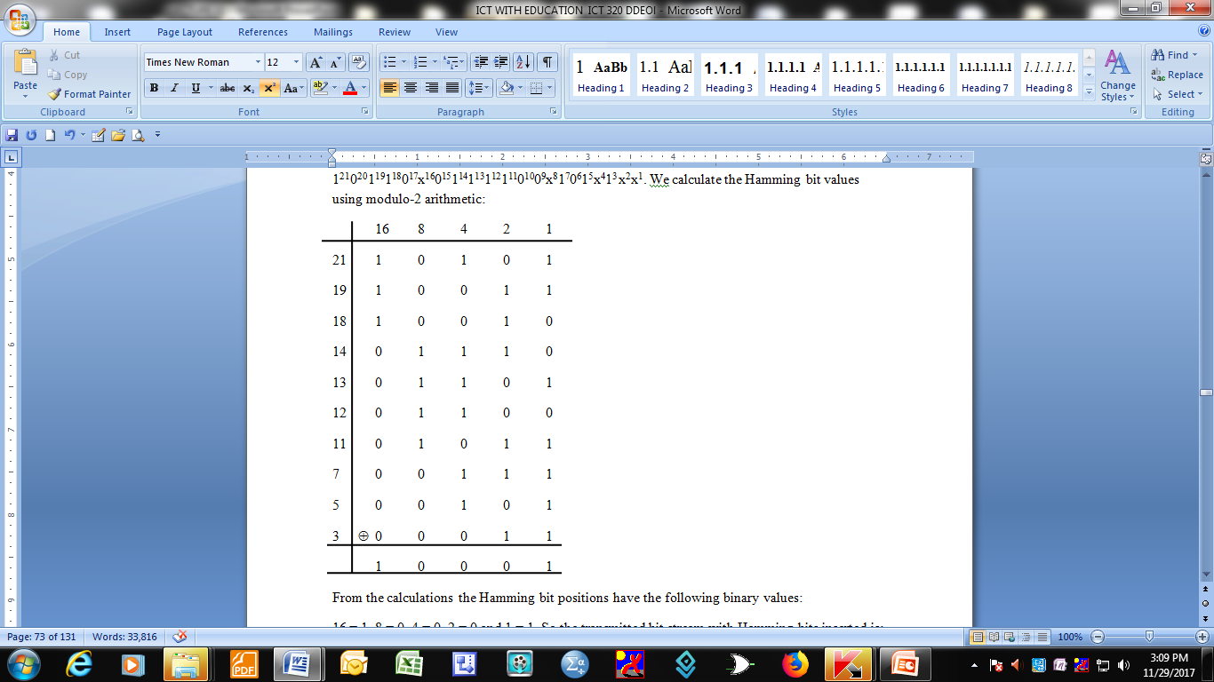

Slide 31
From the calculations the Hamming bit positions have the following binary values:
16 = 1, 8 = 0, 4 = 0, 2 = 0 and 1 = 1. So the transmitted bit stream with Hamming bits inserted is:
101101011110001010101.
If this bit stream is received without errors, the result of modulo-2 arithmetic of all the 1 bit positions (including the Hamming bits) will be equal to zero (0). (see example).

Slide 32
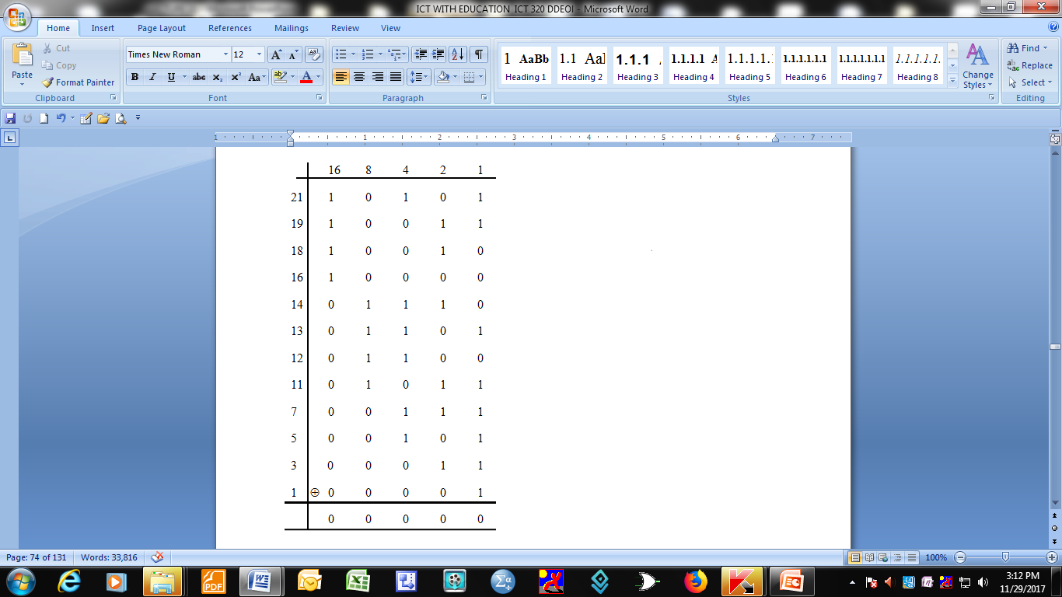

Slide 33
If any one of the bit positions changes its value, modulo-2, arithmetic operation on the transmitted bit stream will indicate the erroneous bit position. For example assume bit position 19 toggled its value during transmission:

Slide 34
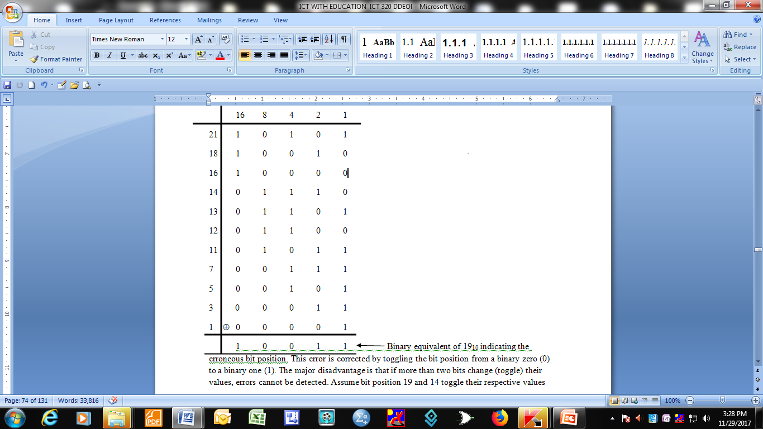
Detecting and correcting error with Hamming Code

Slide 35
This error is corrected by toggling the bit position from a binary zero (0) to a binary one (1). The major disadvantage is that if more than two bits change (toggle) their values, errors cannot be detected. Assume bit position 19 and 14 toggle their respective values

Slide 36
